Slide 1


Understanding When to File :
ASAP,
Captain Irregularity, and
Safety Reports
Effective Safety Management System is vital to the success and longevity of 21Air.

Slide 2
Overview of Aviation Reporting Systems

Slide 3
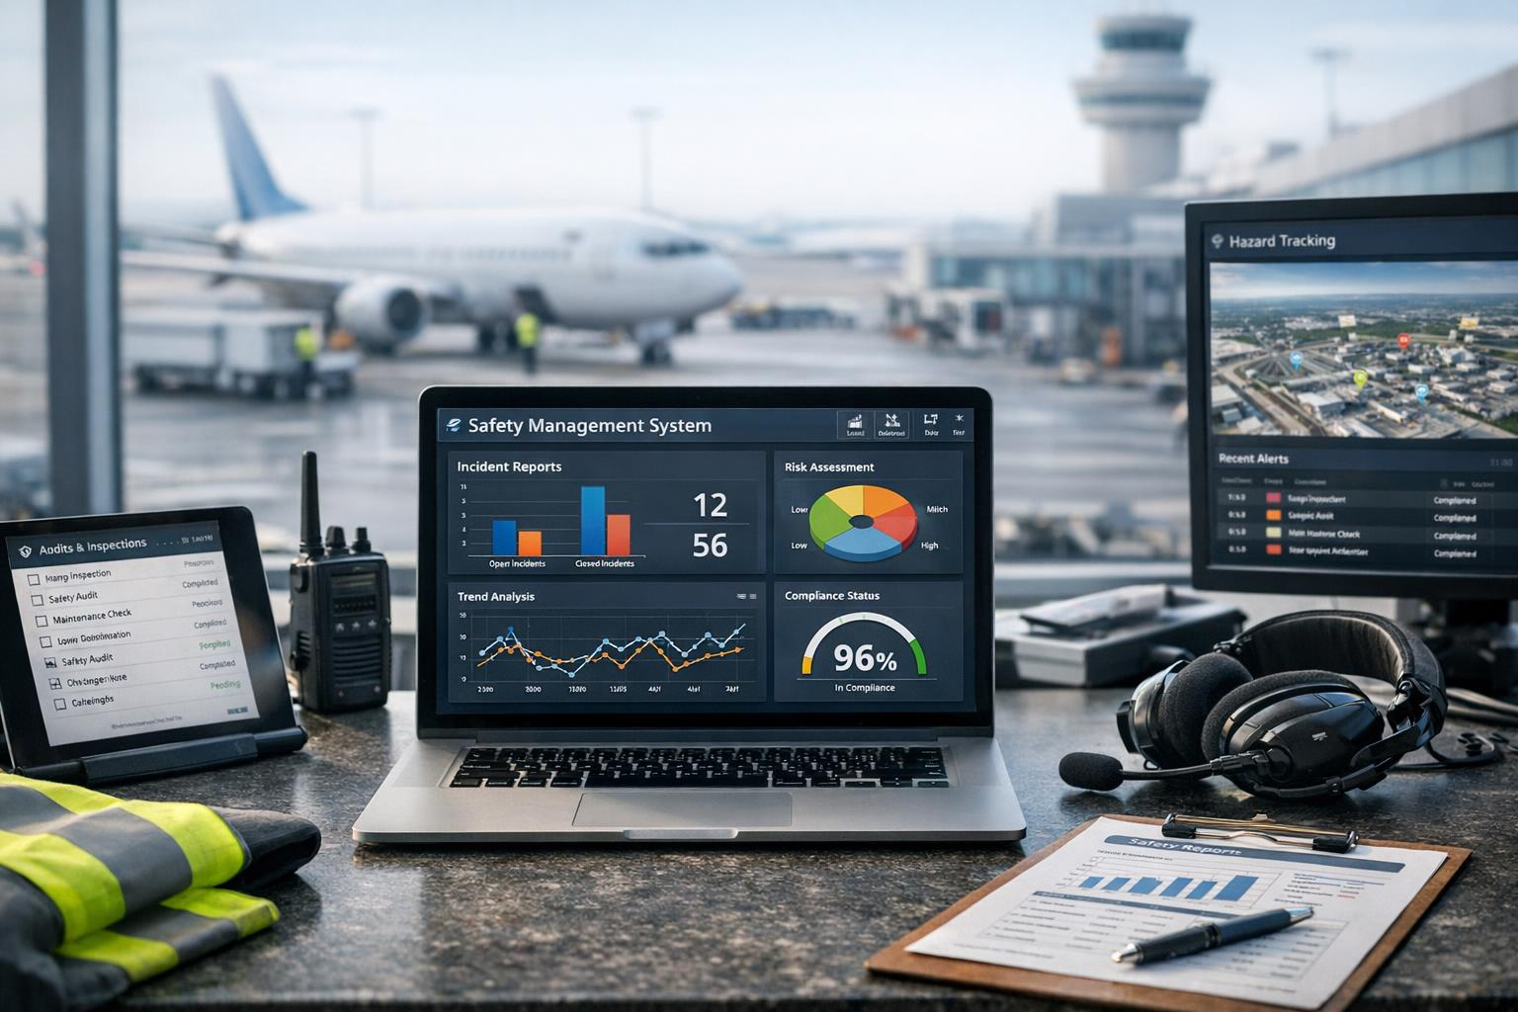
Safety Reporting Benefits
Enhances Safety Standards
Collects and analyzes operational data
Helps prevent accidents and improve safety
Fosters Safety Culture
Encourages reporting without fear
Promotes accountability and responsibility
Risk Mitigation & Compliance
Reduces operational risk
Supports compliance with safety regulations

Slide 4

Types of Reports Commonly Used
ASAP Reports
Potential FAR deviation or certificate implications
Time-sensitive
Proper filing helps protect you
Captain Irregularity Reports
Operational disruptions
Maintenance issues
Passenger-related events
Other irregular situations requiring documentation
Safety Reports
Internal safety concerns, hazards, or trends
No FAR deviation or certificate risk

Slide 5
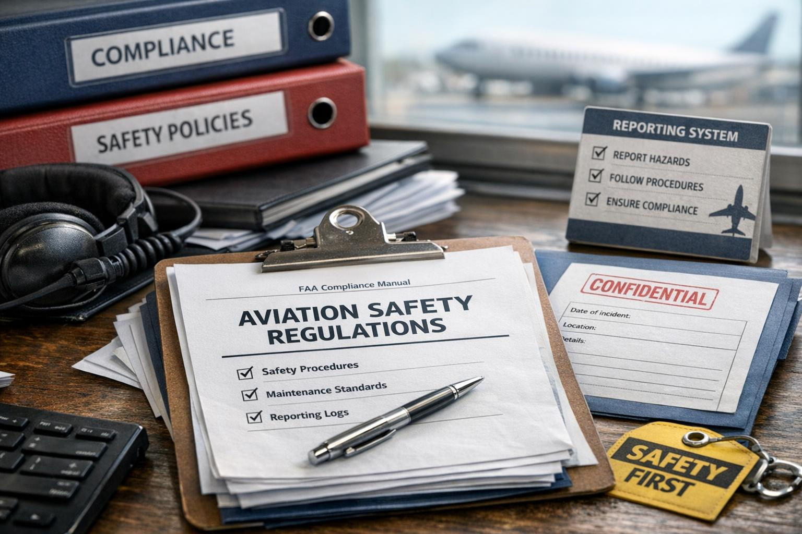
Regulatory Requirements and Company Policies
Federal Aviation Regulations
  FAA mandates incident reporting and promotes voluntary safety submissions through programs like ASAP to improve aviation safety.
Company Reporting Policies
  Companies develop internal policies aligned with regulations to encourage reporting of incidents, near-misses, and irregularities.
Proactive Risk Management
  Enhanced reporting beyond mandatory events supports proactive risk management and improves overall aviation safety culture.

Slide 6

ASAP
Aviation Safety Action Program

Slide 7

Aviation Safety Action Program (ASAP) Overview
What is ASAP?
Partnership between the FAA and certificate holders
Promotes safety through voluntary reporting
Purpose
Identify and track system hazards and risks
Capture all safety events
Not limited to violations

Slide 8

When to Use
Potential FAR deviation
Timing
No strict 24/48-hour deadline
Submit within 24 hours when practical
Timely reporting helps protect your certificate
More Information
Situations with certificate implications
All parties involved/witness should submit an ASAP, NOT just the Captain.
SMS Appendix M in AVDOCS

Slide 9

Situations Requiring ASAP Report Submission
Reporting Safety Concerns
  ASAP reports are necessary when safety concerns such as procedural deviations or equipment malfunctions occur.
Common Reporting Scenarios
  Typical cases include ATC issues, non-compliance with procedures, and flight or ground irregularities.
Importance of Timely Reports
  Early ASAP reporting helps detect hazards early and prevents escalation of accidents.

Slide 10

Benefits and Protections for Reporters
Immunity from Punitive Action
  Reporters submitting ASAP forms receive immunity for inadvertent errors, promoting a transparent and non-punitive culture.
Improved Safety Outcomes
  ASAP reporting enhances safety by facilitating organizational learning and proactive risk management.
Data-Driven Policy Updates
  Data from ASAP reports helps airlines and regulators update policies and training to address root causes effectively.

Slide 11

ASAP Reporting Protections and Limitations
ASAP reports shall not be used for disciplinary or discharge actions or investigations, including System Board of Adjustment proceedings.
ASAP reports will not be accepted if they involve:
Reckless or intentional violation of conduct
The “Big 5” violations
An employee acting outside the scope of his or her employment

Slide 12
The “BIG 5” ASAP Exclusions
Intentional Falsification
Intentional Violations of Regulations
Criminal Activity
Substance Abuse
Controlled Substance and Alcohol Misuse Related to Safety

Slide 13
Captain Irregularity Reports

Slide 14

What Constitutes an Irregularity in Flight Operations
Definition of Irregularities
  Irregularities are deviations from approved flight procedures or unexpected operational events that impact safety.
Common Examples
  Examples of irregularities include equipment failures, ATC deviations, weather challenges, and crew errors.
Importance of Reporting
  Prompt identification and reporting ensures operational integrity and compliance with regulations.

Slide 15

Circumstances Necessitating a Captain Irregularity Report
Incidents Requiring Reports
  Captains must report safety-impacting events like aborted takeoffs, system failures, and passenger disturbances during flights.
Purpose of Reporting
  Irregularity reports ensure captain accountability and support investigations and safety reviews to improve operations.
Operational Improvements
  Reporting incidents enables corrective actions that enhance flight safety and operational reliability over time.

Slide 16
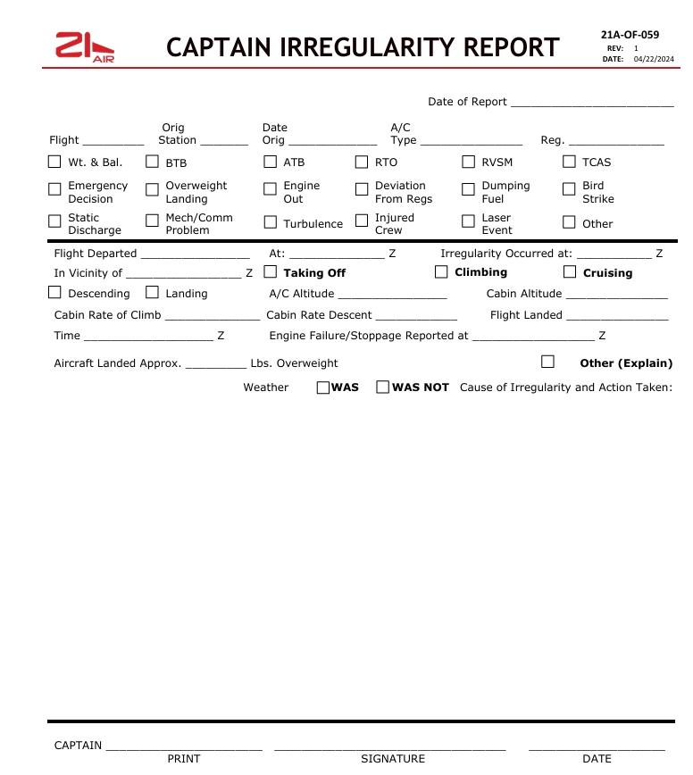
Examples and Best Practices for Reporting
Thorough and Timely Documentation
  Reports should be detailed and submitted promptly to ensure accurate incident tracking and resolution.
Objective and Factual Reporting
  Avoid subjective judgments; focus on factual information such as mechanical issues or ATC deviations.
Standardized Format and Clarity
  Using a consistent format and clear language helps safety teams analyze data efficiently and apply corrective actions.

Slide 17
Safety Reports

Slide 18
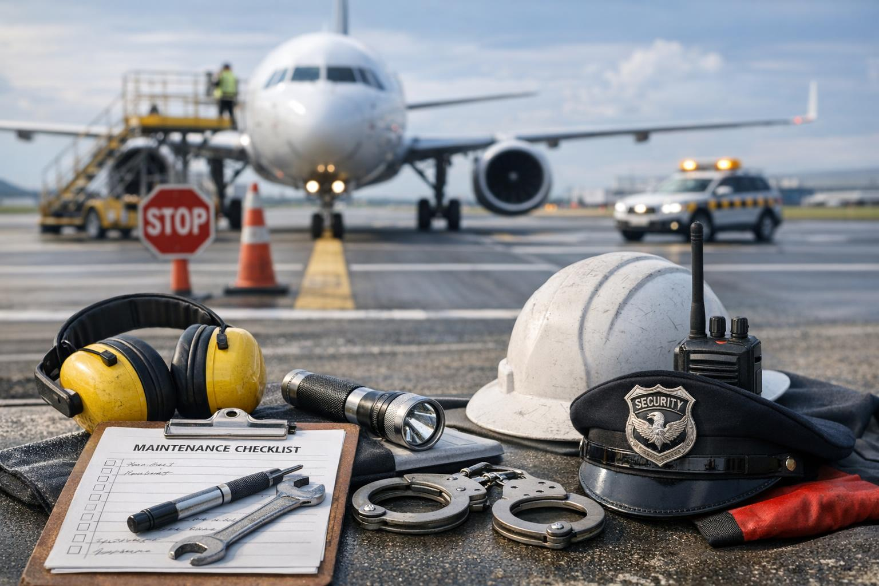
General Safety Events and Concerns
Range of Safety Events
  Safety reports cover events from minor hazards to serious incidents affecting aviation operations.
Examples of Safety Concerns
  Runway incursions, maintenance issues, and security breaches are key concerns reported for aviation safety.
Importance of Data Collection
  Collecting safety observations helps identify trends and systemic weaknesses in aviation environments.

Slide 19
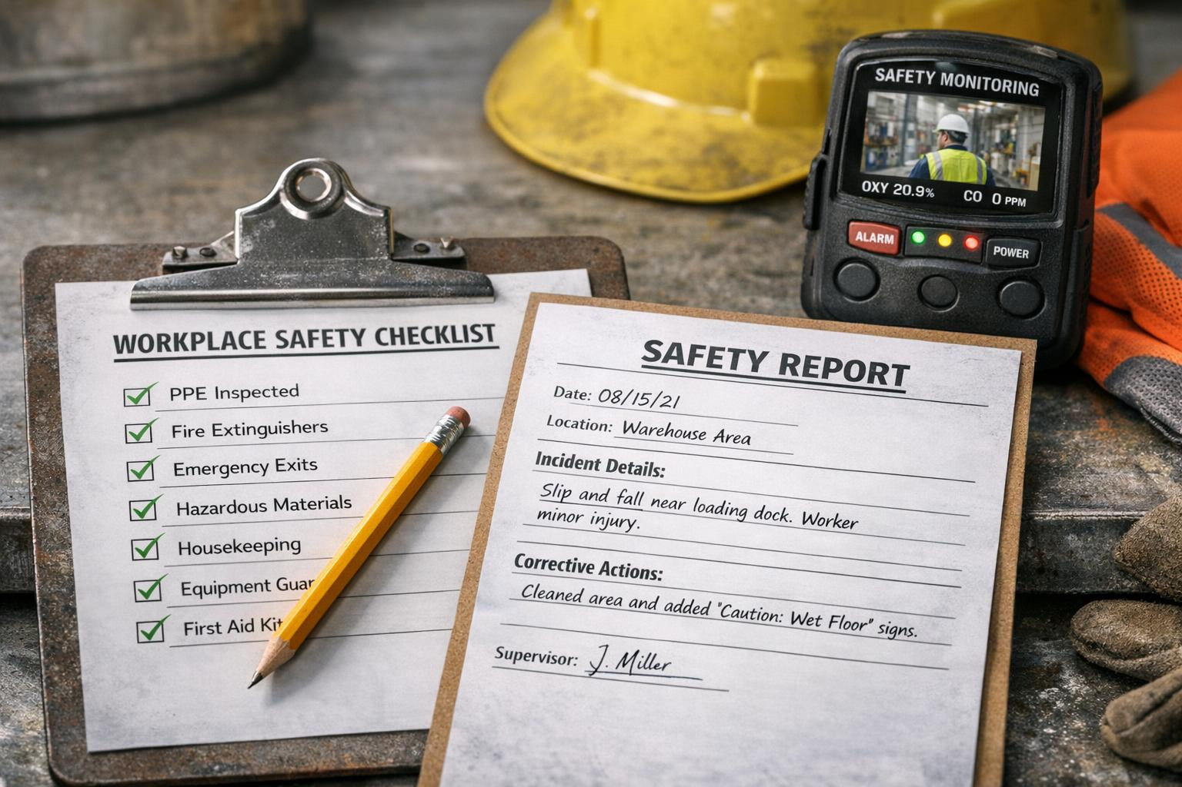
Criteria for Filing a Safety Report
Conditions Requiring Reporting
  Reports should be filed if any unsafe acts, conditions, near-misses, or non-compliance are witnessed or experienced.
Timeliness of Reporting
  Filing safety reports promptly preserves accuracy and allows quick response to hazards.
Purpose of Filing
  Safety reports enable timely intervention and help prevent future incidents and accidents.

Slide 20
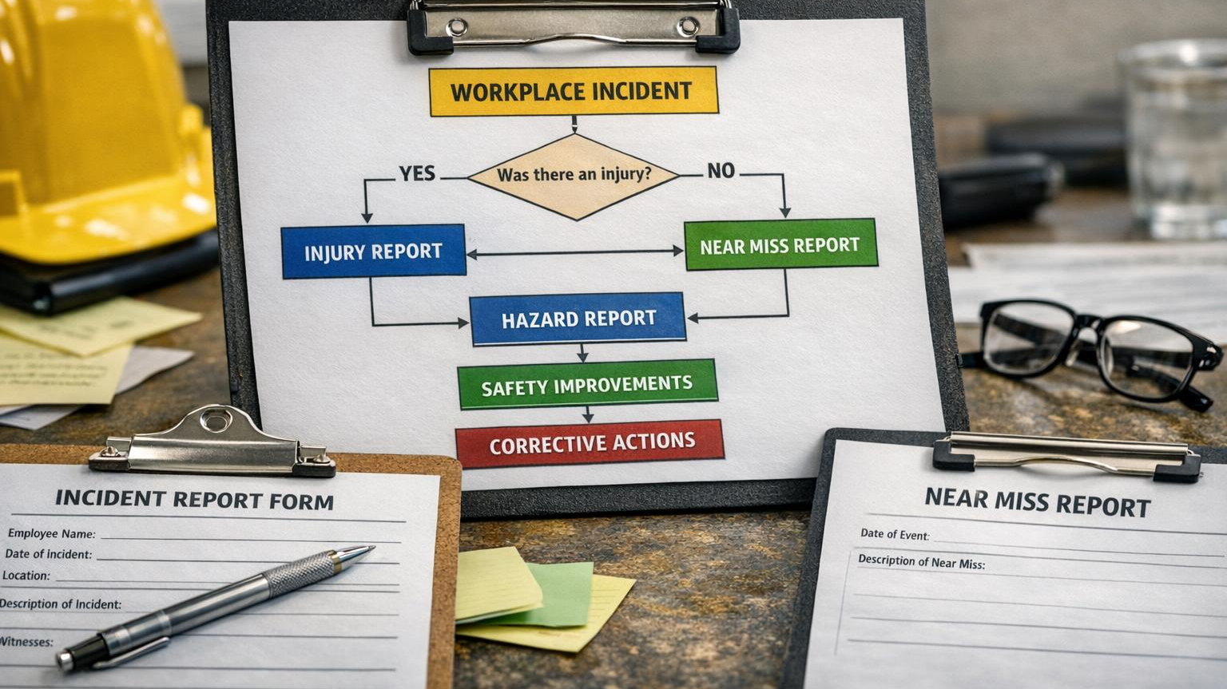
How to Determine Which Report to File
Factors Influencing Report Choice
  Choosing the right report depends on the event type, safety impact, and involved personnel.
ASAP Reports Usage
ASAP is for situations where there may be a potential FAR deviation or something that could have certificate implications.
Captain Irregularity Reports
  Captain Irregularity Reports address operational deviations identified by captains during flights or operations.
Safety Reports
  . A Safety Report is for internal safety concerns, hazards, or trends that impact the operation but don’t involve possible certificate exposure.

Slide 21
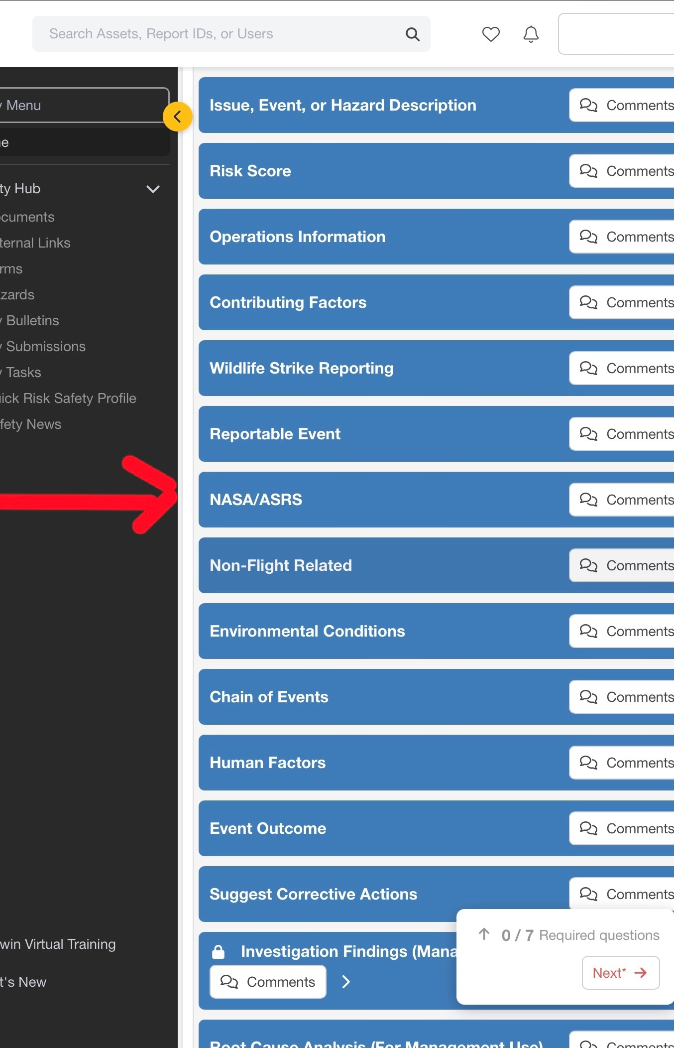
NASA/ASRS Reports
Another option to report a safety event within Baldwin Safety is a NASA/ASRS report.
The NASA/ASRS is a confidential, voluntary, and non-punitive reporting system that collects safety reports from Pilots, Air Traffic Controllers, Dispatchers, Cabin Crew, Ground Operations, Maintenance Technicians, and UAS Operators.
Submissions to ASRS can detail unsafe events, hazardous conditions, or violations, provided the violation was unintentional, not deliberate, and did not involve a criminal act or accident. Report whenever the aviation industry could benefit from your experience.
There is no limit to the number of reports you can submit.
• For protections from civil penalty and certificate violation, you must report within 10 days after the violation (or date you became aware or should have been aware of the violation)
• While you may only exercise your waiver once in a five-year period, you may report as many times as you wish

Slide 22

Reporting Procedures and Timelines
Timely Report Filing
Reports must be filed promptly, typically within 24 hours of the event, to maintain data relevance and support investigations.
Safety Reporting Submission
ASAP Reports and Safety Reports must be submitted through:
https://www.baldwinsafety.com/users/sign_in
Captain’s Irregularity Reports are available on AVDOCS:
21Air Forms → Operations Forms → 21A-OF → 21A-OF-059r1 → Captain’s Irregularity Report
21 Air employees may anonymously report any safety-related issue or concern through the
24-hour Safety Hotline:1-888-533-2620 (GOM 0-8-1) or send a confidential email to: safety@21air.us
Importance of Accuracy
Accurate and timely reporting ensures effective investigations and proper follow-up actions.

Slide 23
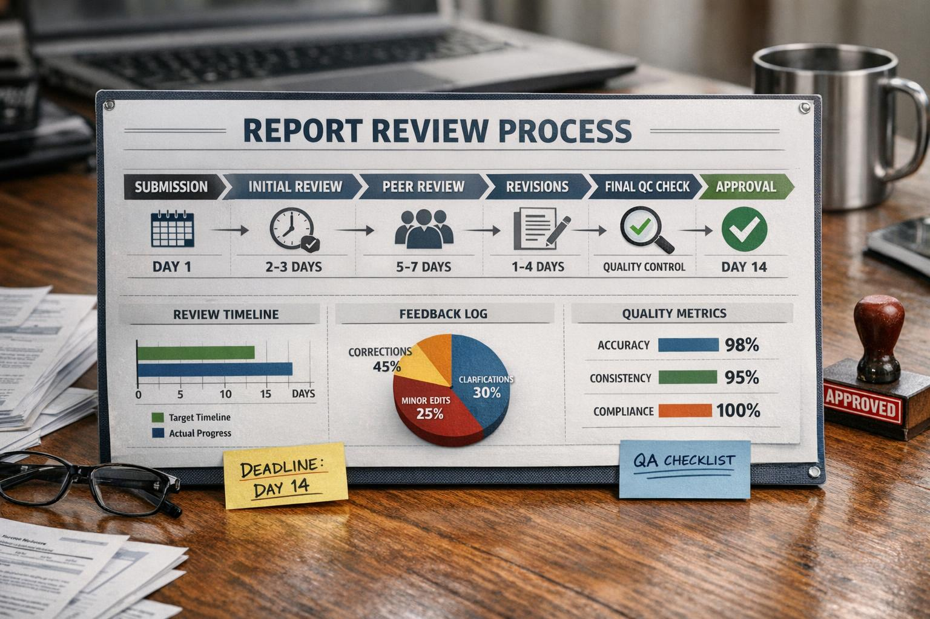
Ensuring Accuracy and Completeness in Reports
Accuracy in Reporting
  Clear and objective descriptions with precise time and location data ensure report accuracy and reliability.
Completeness of Information
  Including all critical facts and observations prevents omissions essential for comprehensive reports.
  There are situations where you would file both a Captain’s Irregularity Report and an ASAP. For example, if there was an operational event that required company documentation but also involved a possible FAR deviation, you would submit the irregularity report for the company record and file ASAP to protect your certificate.

Slide 24
A shared mental model of hazards and risks
Without reliable and persistent reporting, we are unable to anticipate how hazards in our system can produce or combine to create an adverse event.
Remember: When you observe a hazard and fail to report it , you may be masking a hazard, it’s associated risk and possibly creating a latent condition.

Slide 25

Conclusion
If you’re ever unsure which one applies, please reach out to the union first before taking it somewhere else. That is the proper stream of communication, and it ensures you’re getting the right guidance from the start. We can’t effectively protect you if we’re brought in after the fact.
For safety-related matters, you may contact the Safety Committee directly:
Tyler Wilds, Safety Chairman and Zach Leitch, Safety Co-Chairman at: tapasafety@21air.us
Alternatively, you may reach out to the Director of Safety at 21 Air:
Jorge Espinosa (786) 631-2570 / Email: jespinosa@21air.us
The goal is simple. Protect you and protect your certificate
TAPA Safety Committee

