Slide 1

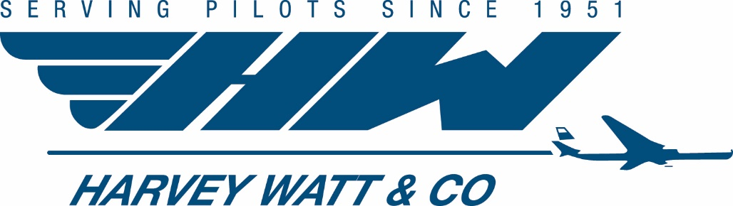

…serving pilots since 1951

Slide 2
History of Harvey Watt & Company
Our Founder - Harvey W. Watt, Sr.
The First Pilot Occupational Disability Plan
in 1951
First Medical Director & Medical Department
Company Evolution Meeting Airlines’ Needs
Notes:
Harvey Watt invented Loss of License Insurance in 1951. Immediately claims rolled in and they set up a Claims Round Table going directly to Dr. Seagull, the US Federal Air Surgeon at the time. They quickly realized no matter how motivated pilots were to get back flying, they missed valuable opportunities for recertification leading to unnecessary claim payments. The pilot’s own AMEs did not know what the FAA needed so Harvey Watt started helping.
The Medical Department was founded with the hiring of our first fulltime Medical Director and word quickly got around that if you bought Harvey Watt insurance, they were fair and they’d work overtime to help you back into the cockpit. Every day Dr. Gullet worked directly with the FAA advocating for pilots.
They ended up getting enough pilots back to work that they saved the future of the plan. The process, 7 decades later is far more sophisticated & thorough but it all started there.
Eventually every airline at the time from American to Pan AM had payroll deduction and actively endorsed buying the coverage by providing mailing lists to Watt so their airmen could gain access to the AeroMedical services. They saw it saving their airline money by getting pilots back to work faster.
Harvey Watt worked so closely with the FAA helping pilots that the doctors made him an Honorary Fellow in Aerospace Medicine– the only non doctor to receive such honors.

Slide 3
Exclusive Provider: Loss of Medical License Insurance
TPA Claims/Absence Management
Outsourced Airline Medical Department
FAA Medical Certification Representation
STD & LTD Claim Management
Sick Leave Verification
Fitness for Duty Evaluations
HIMS Program Administration
Return to Work Documentation: Confirm pilots are legal to fly
Airline Industry Benchmarking
  Best Practices & Policy Design
Pilot Claim Handling for Insurers
EOI Underwriting
Aviation Medical Bulletin
Aeromedical Claims Assistance
Notes:
Over 70 years, we built a great reputation. Flight leaders and their pilots who had to rely on our services when grounded had seen our expertise first hand so they called us to do more as their company and needs evolved. We designed these new programs at their request.
We act as a firewalled independent medical resource all centered around knowing when a pilot can fly legally and what it would take to get the pilot cleared. We currently act as the named company Medical Director for airlines working with Labor Relations & Flight Ops overseeing HIMS substance abuse programs, Fitness For Duty Evaluations, and verifying pilots are legal to fly as our doctors clear airman to the cockpit- reducing company and pilot liability. Due to the many carriers we are fortunate to work with, we are able to assist with plan design, benchmarking and claims best practices.
All of these company functions leverage our AeroMedical Expertise

Slide 4
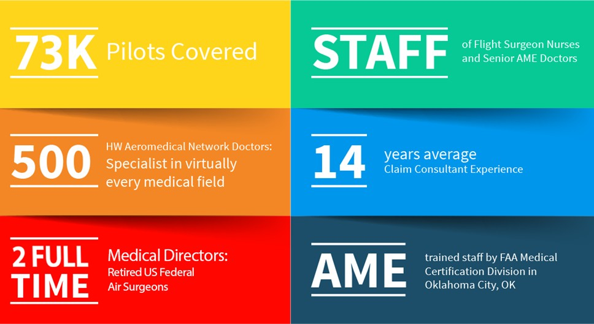
Notes:
Today we work with over 76,000 pilots making us the world’s largest pilot absence manager serving airlines in US, Canada, EU, and UAE. In addition to self insured plans, insurance underwriters have seen our positive impact on claims and reduced claim escalations when they hired us - so many insurers today will only write this coverage with our partnership.
On your account reviewing cases are Dr. Tilton & Dr. Berry. Both are former US Federal Air Surgeons who oversaw the FAA Medical Certification Division and work along with Flight Surgeon Nurses and AME trained Medical Consultants.
The HW Aeromedical Network of Doctors is a proprietary network we have developed of vetted independent specialists across the country. For Independent Medical Exams (IME) or IME file peer reviews, this network has the top experts familiar with pilots. We originally developed a pilot evaluation program with Mayo Clinic and have since expanded the program. For Example, we have a presiding member of the FAA Cardiac Review Panel in that network to review Cardiac cases as well as the FAA’s very own Neurology Consultant.
We recruit seasoned claims consultants from other companies carrying years of experience and then train them for pilots. This includes a 6 week indoc training, pre-rec testing by the FAA, and an exclusive agreement with the FAA for Oklahoma City training with their doctors. Consultants receive recurrent monthly training, and round table case discussion based on the latest FAA updated policies.
Our training is so good that the current US Federal Air Surgeon hired three of our consultants and now everyone in the company signs non-compete forms specific to the FAA.

Slide 5
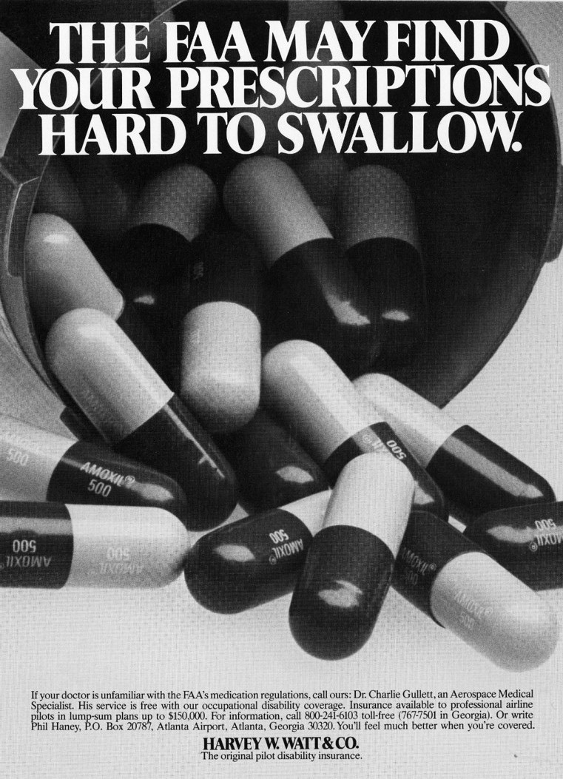
The Pilot is Different
61.53 Federal Aviation Regulations: Safety vs Capability
Standing monthly call with the US Federal Air Surgeon
Unpublished: 200+ changes estimated annually
Published: 15 Specifically Disqualifying Conditions
FAA pharmacologist updates unpublished medication list
Harvey Watt stays on top of the changes:
  2 former US Federal Air Surgeons that hired/recruited many current FAA CAMI Physicians & Chief of FAA Med Cert Div
  Volume of cases: work with over 4,000 pilots annually
  Oldest corporate member of Aerospace Medical Association, Airline Medical Directors Association, Civil Aviation Medical Association, International Academy of Aerospace Medicine.
  A4A, IATA, & NATA partner
Proprietary Resources
  Updated internal guidelines for FAA approved treatment plans, medications, required testing, & grounding periods
  Suggest & make airman aware of alternative FAA Approved treatment plans to avoid letting a single medication prevent a pilot from flying
Notes:
This slide hits exactly at the core of the challenges for Pilot Loss of Medical License Claims and why we are the only solution.
FAR 61.53 Prohibits pilots from flying when they are disqualified. The responsibility is placed on the Pilot & Operator to not fly when disqualified due to a condition, history, or treatment. This vague language means it is a felony to operate an aircraft when you are disqualified.
But as a Federal entity, the FAA cannot publish all of their Certification Regulations because they would then be considered a matter of Federal Policy & subject to time delays and public comment periods before those changes can be made. As a result, most simply aren’t published and the regulations you saw on a case last week can change tomorrow. There is a fulltime pharmacologist that reviews and updates the internal list of approved medications almost daily. You’ll note there’s been 32 unpublished changes this year and only 15 specifically disqualifying condition published.
We are fortunate enough to have a standing call each month with the Federal Air Surgeon’s office, in which we are updated on the latest unpublished changes and given a heads up as to potential changes. With a pilot’s signed FAA HIPAA Release we are able to represent the airman to the FAA, and prior to the call give their FAA PI case number. They’ll have time to review the pilots case in advance so that we can discuss on the call. This leads to expedited case review. For unique cases, we can discuss a case anonymously to determine accurate case handling.
Any questions?

Slide 6
New Plan Features
Short Term
Loss of Medical License Insurance
30 day waiting period from initial grounding
22 week benefit duration
Pilots earning $135k+ eligible for weekly benefit of $1,730
Pilots earning less than $135k are eligible for weekly benefit of $1,154
PEPM Rate: $73.50
Long Term
Loss of Medical License insurance
6 month waiting period (when STD ends)
2 year benefit duration
Pilots earning $135k+ eligible for monthly benefit of $7,500
Pilots earning less than $135k eligible for monthly benefit of $5,000
PEPM Rate: $93.50

Slide 7
Individual Disability Coverage vs. 21 Air
Employer-Sponsored Benefit
This comparison highlights the relative cost of purchasing individual Loss of Medical disability coverage vs participating in the 21 Air employer-sponsored benefit.
Individual coverage thru Harvey Watt (*requires medical underwriting)
• Age 40: $310 / month (short + long term)
• Age 50: $659 / month
• Age 60: $1,653 / month
• Max short-term benefit: $1,500/ wk, Long Term $7500/mo
21 Air Employer-Sponsored Benefit (Salary > $135,000) -
Guaranteed Issue coverage
• Short-term benefit: $1,730/ wk, Long Term $7500/mo
• Monthly value: ~ $167 / month
Pilots would only pay taxes on this employer paid premium amount vs individual prices above.
Tax Example (Illustrative)
• Pilot in a 24% tax bracket
• Tax owed on employer-paid premium:
$167 × 24% ≈ $40/month

Slide 8
Plan Comparison
Harvey Watt
SunLife
  Loss of license LTD coverage that expedites FAA recertification through specialized Harvey Watt representation in addition to benefits traditional coverage provides
  Plan is 100% Employee-Paid – Plus salary gross up to be tax-free benefit
  Flat monthly benefit based on earnings
  24-month own occupation period that includes loss of license
  30 day STD coverage until grounded for 6 months and then LTD provides another 2 years LOL Eligible for this benefit first of the month following date of hire
  Traditional Disability coverage where once the treating physician deems an employee is fit to return to work, disability payments will end regardless of FAA recertification
  Excludes Disability Due Solely from Loss of Professional License
  Plan is 100% Employer Paid
  STD: 60% benefit to a maximum monthly benefit of $1,600 weekly taxed after 15 days payable until 6 months disability
  LTD: 6 month waiting period 50% of income to $7,500 taxed until SSNRA if disability starts after the age of 60
  90-day Elimination Period before benefit begins after claim is filed

Slide 9
Traditional Disability VS Loss of License
Safety vs capability
Unpublished FAA regulations, AME Guide, interpreting that information to apply to the pilot’s case
Avoiding missed opportunities to get back to the cockpit.
When policy changes occur that could affect previous case reviews, help guide us as to what to look for (diagnosis ICD9/ICD10 code)

Slide 10
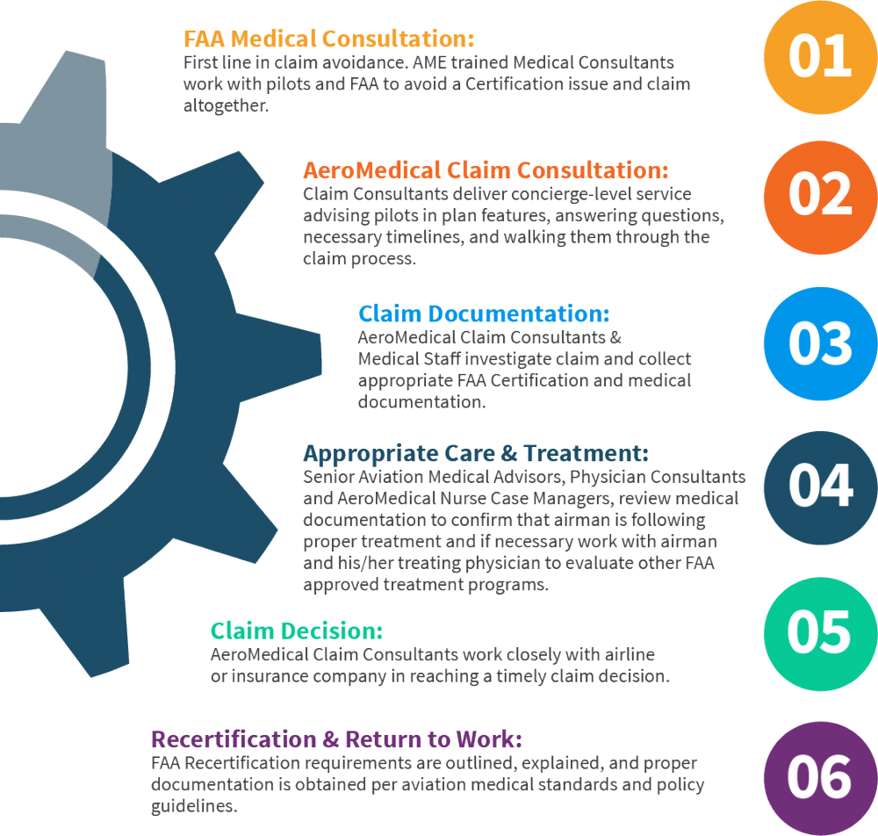
The Harvey Watt Process
Full-service absence management process provides significant cost savings:
Clinical Management
Reduce duration of benefits
Timely claim approval & closure processing
Avoid unnecessary escalations & plan abuse
Improved employee relations
1st Class Medical Certificate: FAA Protocols
Client specific process, call script, culture training, letter library, and designated consultants
State-of-the-art reporting technology
Partnership with the FAA to Support RTW
The AeroMedical difference.
Notes:
Here’s an example of the claims process for a made up pilot that has a heart attack. We start with a Consultation to discuss the claims and FAA process. There we share guidance such as advising the pilot to let his medical lapse and not pursue a FAA denial. This step alone can save weeks or months at the end of the claim because if there is not a denial, a pilot can immediately renew his lapsed medical once his Cardiac Special Issuance Authorization is approved. With a denial, the airman has to take a new physical, have it deferred to OKC, and then wait for the FAA to review the entire health history plus the Cardiac condition to then snail mail a new Medical.
We assist the pilot in collecting their medical records and work in concert with APA speaking almost daily.
Within 24 hours of the first report, Medical Specialists conduct an initial investigation of all the facts, including the background and medical information in the claim.
This pilot's stent is placed in the left main artery, so that airman has a 180 day FAA Wait & See Period rather than a 90 day. At the 181st day and not a day sooner, he must undergo at a minimum: blood tests, nuclear stress test, and a post event heart cath. Additional testing and/or documentation is needed based on diagnosis.
The claims consultant will Approve & certify the claim benefits based on the FAA 180 day timeline and diary follow up to ensure testing is scheduled at proper intervals based on the airman’s unique situation.
The FAA Cardiac Review Panel meets only once every other month and if the tests are done too soon or too late, they will not be accepted by the Panel. When the case is submitted, we certify the claim and follow-up based on the expected Panel decision response date.
We just recently had a case in which the pilot’s ejection fraction was varying greatly and the FAA typically requires a 50% or greater ejection fraction. Instead of waiting for the FAA to render a decision, we spoke to a doctor on the Panel, described the case, and he said he would approve the case with a MUGA scan. The pilot took the test, submitted it, and that doctor on the board cleared him.
The key is to do all this without the pilot feeling alienated and rather supported. In steps 3-6 we collaborate with the pilot in collecting the claim documentation and when it comes to making the claim decision we pull from all of that documentation. In the Recertification step, its very helpful as we are able to incorporate & validate the recertification process is being properly managed.
It’s estimated that for every dollar paid out to a pilot as a disability benefit that it costs the airline another $10 in associated costs. The costs include replacing that pilot with another First Officer type rated in the aircraft or even replace the aircraft, reposition them, etc.

Slide 11
Your Team
Medical Directors & former US Federal Air Surgeons: Dr. Tilton & Dr. Berry
Team Manager: Keila Culbreath
Quality Analyst/Auditor: Annicka Glanton
Sr. Flight Surgeon Nurse: Dana Knight-King
AeroMed Claims Consultants: Low case counts and designated assignments
Administration & Support team provide customized service experience
Additional staff are cross trained on each account to assist.
Notes:
We have very good people with lots of experience and training working for you.
All employees are thoroughly vetted and undergo a battery of testing for job fit, capability, and emotional compatibility. We found that Guardian Supervisor is the best personality type of to fill our claim consultant role.
Consultants average 14 years experience. Every case is medically reviewed. Our organizational structure is unique with all claims assigned to Claims consultants for management & oversight with a large supporting cast of 2 doctors, 1 nurse and 2 claims assistants and three support staffers. This maximizes the senior case managers’ time. We also have examiners on other Major Airline accounts that are cross trained to provide assistance in times of claim spikes.

Slide 12
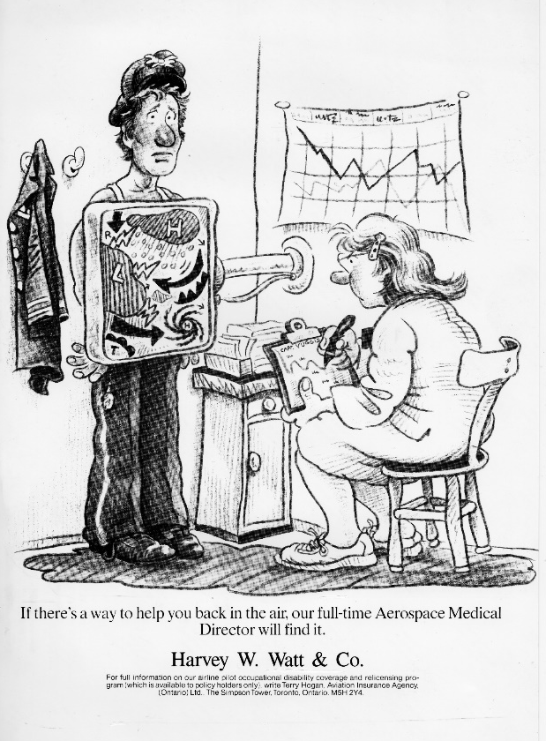
FAA Trained Claims Consultants
Making your life easier
Red Carpet Service: Strong emphasis on customer service
Only Harvey Watt & Co has permission for Claim Consultants to undergo the AME Aeromedical Examiner training at the FAA headquarters in Oklahoma City.
This training includes certification in the following courses:
  The Clinical Aerospace Physiology Review for AME’s;
  The Medical Certification Standards and Procedures Training and
  Aerospace Medical Examiner Seminar held at the FAA Civil Aerospace Medical Institute
Dedicated claims team trained | Never “floating staff”
Tone of voice, culture, Airline preferences, what pilots can expect
Assigned a specific Claims Advocate through your entire process with consistent support
Claim Consultants know what to look for. They can do a better job managing an aviator’s disability claim than anyone else and gather the specific documentation needed to confirm a disability, help the pilot complete his/her claim, request information from doctors, and rule out alternatives
Take time on the phone: Average 33 minutes
Notes:
This is a historical ad from the 60s encouraging pilots to call our doctors and let us help.
We understand this is the hardest time in most pilot's career and likely the only time in their life that they’ve lost full control. When pilots contact Harvey Watt to file a claim, they don’t have to undergo the headaches that so many experience when dealing with less knowledgeable claim examiners; having to explain why their condition is disqualified under FAA medical standards.
They’re assigned a constant person that a pilot can work with for years and develop a rapport that makes the process run smoothly. We never use a floating staff model where pilots can fall on someone’s desk that’s not familiar with American.
We know when we can impact a claim and when we cant. We set expectations early and ensure that they are followed. We don’t ask for unnecessary documentation or determinations from the FAA that can cause a pilot to have a denial on his record that he/she will need to report for the rest of their career.
Our consultants spend an average of 33 minutes taking their time on the phone with the pilots which is noted often in surveys.

Slide 13
Clinical Management & Resources
Only recognized FAA Aeromedical Advocate processing claims
Monthly Standing Call with US Federal Air Surgeon chief case reviewer
Flight Surgeon Nurse Case Manager & Senior AMEs avg 40+ years' experience
Every case is medically reviewed
Pilot Disability Management System: Pilot specific fields and data logic reporting built through our experience serving all major US airlines, and major US LTD insurers
Proprietary database to identify candidates affected by FAA unpublished changes.
  FAA CRGs including the “List that doesn’t exist”

Slide 14
Electronic Surveys
Client Survey: 23 Questions ranked 1-5 (highest)
Pilot Approved Claim Survey: 6 Questions ranked 1-4 (highest)
Pilot Closed Claim Survey: 12 Questions ranked 1-4 (highest)
Automatically system-generated customer service surveys are sent to every single person we work with - whether they open a claim or just call for a consultation at case closure
Full time customer service representative attached to team
  Follow-up by phone, email, or text for completion
  Average a 60% response rate.
    Industry average is 50% threshold for validity
Year | Avg Pilot Approved Survey Scale 1-4 (excellent) | Avg Pilot Closed Survey Scale 1-4 (excellent)
2023 | 3.81 | 3.8
2024 | 3.81 | 3.92
2025 | 3.90 | 3.92
Notes:
Our survey results have been excellent and here are the results for the past 6 years.
Airline benefits leadership is provided a 23 question client survey each year with a ranking of 4 as “Exceptional” and 5 being “Exceeding Expectations”
Pilots are sent automated surveys from our claim system when their claim is approved and again at claim closure when they’re done working with us. The highest ranking of 4 is Excellent.
To ensure a high response rate, we have assigned an employee, Patsy, that spends the majority of her time following up on Surveys via phone to take them verbally if unsuccessful by email. We’ve averaged nearly a 60% response rate consistently exceeding the 50% industry threshold for validity.

Slide 15
Systems & Reporting
Software built by Progress, Inc., leader in disability claim software
Eligibility feed capabilities for daily data transfers, claim alerts, dashboard reporting, specialized reports & distribution trees by base and pilots
Quarterly Stewardship Report
Performance Guarantee Reporting: Audit results, Customer & Client Survey Results
Tailored tracking fields: FAA Medical dates, Est FAA RTW, Base, Admin DoD, Fleet Type, Line Flown, Crew Base Flight Administrator (CBF), Legacy Code, Plan version
E-Nod process streamlined to update base specific changes & distribution changes
Daily Automated & manual communication distributions in place
Secure file upload, paperless filing & indexing resulting enhanced workflow management
PDMS Tech:
  Automatic System Triggers: FAA 8500-8, Disqualifying condition, Disqualifying medication
Notes:
Our proprietary Pilot Disability Management System allows for full customization and reporting. It tracks multiple LTD plans, pilot groups, and airline specific fields. We have daily eligibility feeds that automatically upload to our system and from our system to numerous airline recipients; sending reports automatically. Enods (Electronic Notice of Disability) are sent instantaneously from the system by checking a box.
The formatting and file encryption type are all currently provided at American’s request but can be changed to any required.
PDMS gives us the ability to identify pilots who may be affected when we learn about published and unpublished FAA regulation changes. Without that, a single missed case can cost millions.
We added a new secure file upload portal link for claimants and a paperless filing methodology.

Slide 16
Requesting AeroMedical Assistance Without A Claim
HarveyWatt.com click Contact Us
Or Contact Us:
  avmed@harveywatt.com
  800-241-6103
Notes:
We are maneuverable and here to help pilots in anyway possible.
Pilots can initiate a claim call using telephonic claim intakes, request claim text message updates, and apply using an Online Claim application.

Slide 17
How to Submit a Claim
Two ways to submit a Disability claim:
Call 1-877-377-6773
  Please call between 8 a.m. and 8 p.m. ET, Monday through Friday.
  A customer service representative will initiate your claim and assign it to a case manager.
www.symetra.com/myGO
  Click “Start a claim.”
  Answer the prompted questions.
  Add any notes or comments.
  Submit form to Symetra
Once your claim intake is completed—either online or by phone—your case manager will call you within two business days to conduct a brief interview and will work with you throughout your period of disability.

Slide 18
How to Enroll
If you have any additional questions on the Harvey Watt Pilot LTD Policy please call or e-mail:
  pilot@harveywatt.com
  800-241-6103
  CLICK HERE: Schedule a time to discuss new policy options with the Harvey Watt Team

Slide 19
Commitment to You
Reduced benefit durations by FAA advocating for pilots
FAA Recognized AeroMedical Advocacy Organization for professional pilots
Ensure pilots have great experience and getting all of the help they need through this difficult time
Have cases worked by the best experts & FAA resources
Excellent Scoring: Audits, Pilot Surveys, Client Surveys
Maneuverable and focused enough to listen and make changes quickly
Quality, efficient, specialized, experienced, Aero Medically Centric
Any part or material of claim process can be changed quickly:
Correspondence, Claim process, Assigned case manager
Promise: Absolutely no one values your business or the success of your program more than we do. This is all that we do.
Notes:
With Harvey Watt you have a company completely dedicated to you and you have our full undivided attention at all times.
Per all measurements we’ve scored well. Over the past 9 years, we’ve received excellent pilot survey scores, American Benefits survey scores, and audit scores.
From doctors, to training, to expertise, and customer service; there is no better option than us.
We know that there is always room for improvement and are committed to both researching where we can improve and also making any changes you’d like to see quickly.
In one year, if we improve claims experience by less than 1% then we’ve saved more than you pay us. That can come from good case management, responsiveness, or identifying a pilot who has been out for years thinking he was permanently grounded until we learned of an unpublished FAA approval of his condition.
Without us you have to rely on the pilot to know when to ask the right questions or those cases alone will cost you millions of dollars for 30+ years.
There is no other American Airlines and because we are so specialized, we have to do it better than anyone and excel in our commitment to excellent service.
We promise that no one values your business or success more than we do.

Slide 20

Questions
and Answers
Serving pilots since 1951

Slide 21
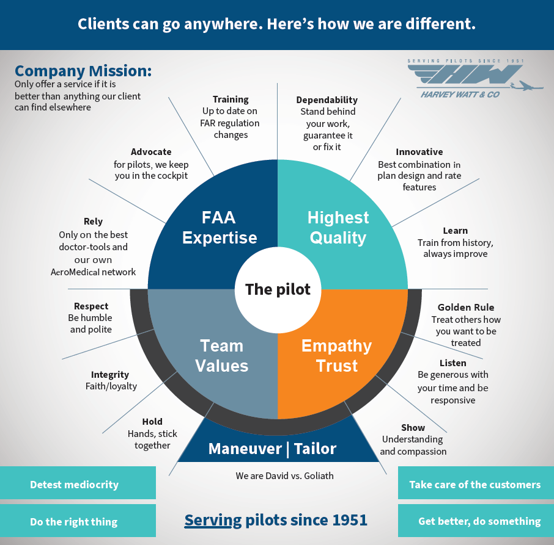
Notes:
Founded by pilots to serve pilots
We have this posted in every room, at each desk, and on our intranet. The pilot is at the core - Quality, FAA Expertise, and Values all stand on a foundation of Maneuverability Tailored to you. We have to continually improve and care more about you.
We got the first pilot cleared with one eye by proving to the FAA that depth perception was a learned trait sitting up high in an airliner. We had another pilot who had been disabled for 13 years with a nerve issue in his leg that we were able to get cleared with a Medical Flight Test, or a just a pilot with a blood clot in his leg that we made sure the pilot was having monthly blood INR testing done that the FAA would require although his treating doctor thought it was overkill. A pilot disabled due to a disqualifying condition such as Irritable Bowl Syndrome treated with a mild antidepressant could think that he is permanently grounded. If the FAA decides you can take the medication for that condition internally and we find out about it, we can find that pilot and let him know the good news thus saving millions.

